Slide 1
Learned in 35+ Years of Dissertation Consulting
35+ Quantitative Landmines
By Tom Granoff, Ph.D.
and Debra A. Fisher, Ph.D.

Slide 2
Overview
Introduction
Topic Selection
Research Design
Sample Size
Institutional Review Boards (IRB)
Instrumentation
Data Collection
Data Analysis
Negotiating with Your Committee
Other Landmines Confronted Over the Years
Good Books and Resources

Slide 3
Introduction
Clearly decide if you are doing a “practitioner’s dissertation” or an “academic dissertation.”
Practitioner’s dissertation=Basically a giant term paper
Academic dissertation=additional goals besides graduating
Success is best achieved when you are clear about the goal but flexible about the process of getting there – Brian Tracy

Slide 4
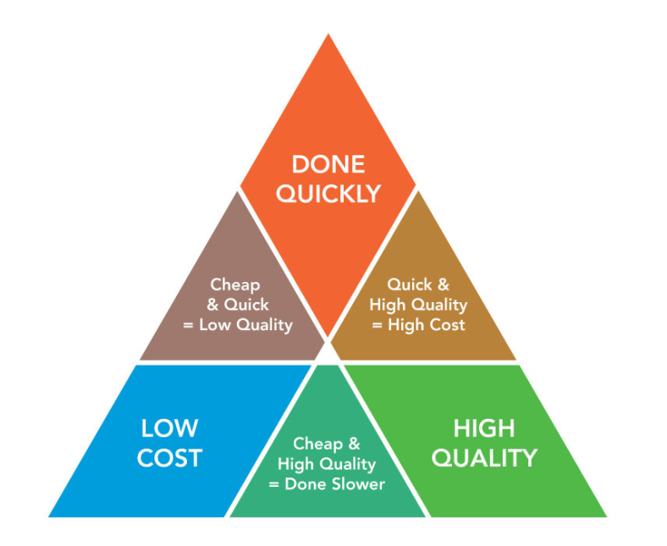
Introduction
Project management triangle: three angles (quality=good, time=quick, resources=cheap).
Given tuition costs…for most, the best dissertation is a done dissertation!
“Done is better than perfect.” ~Sheryl Sandberg COO Facebook
Marginal rate of return
(more is not always better)

Slide 5
Introduction
Sample correlational dissertation:
Leadership Styles and Faculty Satisfaction in the State University System of Florida by Justin Ted Bateh (2013; UMI No. 35667722)
Purpose Statement: “The purpose of this quantitative correlational study was to examine the relationship between perceived academic administrator leadership styles and job satisfaction of full-time faculty members.” (Bateh, 2013, p. 5).
Sweatshirt Hypothesis:
Good Bosses Have Happy Employees.

Slide 6
Introduction: Bateh (2013) Example
Research Questions (RQs):
Primary RQ1: What is the relationship between perceived administrator leadership styles and job satisfaction of faculty members?
Secondary RQ2: What is the relationship between perceived transformational leadership styles and job satisfaction of faculty members?
Secondary RQ3: What is the relationship between perceived transactional leadership styles and job satisfaction of faculty members?
Secondary RQ4: What is the relationship between perceived passive/avoidant leadership styles and job satisfaction of faculty members?

Slide 7
Introduction: Bateh (2013) Example
Primary RQ1: What is the relationship between perceived administrator leadership styles (IV) and job satisfaction (DV) of faculty members?
Independent Variable (IV) = Impact/Influence
Dependent Variable (DV) = Score depends on the IV level
Primary Hypotheses:
H1o: There is no significant relationship between leadership styles and job satisfaction of faculty members.
H1a: There is a significant relationship between leadership styles and job satisfaction of faculty members.
Sweatshirt Hypothesis:
Good Bosses Have Happy Employees.

Slide 8
Topic Selection: Consult Similar Studies
Substitute: Convert leadership to emotional intelligence
Combine: DV = faculty job satisfaction + publications
Adapt: Longitudinal leadership training program
Modify: Sample: faculty members → call center employees
Put to other use: IV=Parenting skills, DV=Child well-being
Eliminate: Only use transformational leadership as IV
Reverse: IV: faculty job satisfaction, DV: student success

Slide 9
Topic Selection: Thoughts on Saving Time
International Personality Item Pool (www.ipip.ori.org) contains 463 free validated and reliable scales.
Mental Measurements Yearbook with Tests in Print
Consider using an archival dataset (i.e., https://fedstats.sites.usa.gov) and build topic around it.
CDC health, education, criminal justice, Census bureau, etc.
Free giant SPSS datasets with comprehensive data dictionaries
Avoid many IRB issues by using archival de-identified data.
Curse of an interesting topic
Passion about a topic can be inspirational and motivational.
However, passion might also lead to unneeded work / delays to graduation.
For most students, it’s better to narrow topic and graduate sooner.

Slide 10
Research Design Considerations
Correlational design is the most common, which is a descriptive (nonexperimental) quantitative approach that explores possible relationships among two or more variables.
Avoid a longitudinal design (data collected at two or more points in time) to prevent waiting to gather posttest data. Use cross-sectional design instead (data are collected at one point in time). Exception is when you are using an archival dataset.
Avoid restriction of range issues. Don’t just sample elites or underperformers. Sample variation makes it easier to achieve sample size of 100.
Consider a comparison group—not just African-American males; add Latino males (easier to achieve sample size).

Slide 11
Research Design Considerations
Use only one perspective (no 360-degree feedback evaluations). Don’t compare leader’s self-ratings to staff ratings of them (no statistical significance; confidentiality issues when combining leader/subordinate perspectives).
For example, in Bateh’s (2013) study, he only measured: (1) faculty members’ perceptions of administrator leadership styles; and (2) faculty members own job satisfaction.
Design your study with your data availability in mind (~100 participants).

Slide 12
Research Design: RQs and Hypotheses
Bateh (2013) Dissertation | Suggested Revision
Primary RQ1: What is the relationship between perceived administrator leadership styles (IV) and job satisfaction (DV) of faculty members? Secondary RQ2: What is the relationship between perceived transformational leadership styles and job satisfaction of faculty members? Secondary RQ3: What is the relationship between perceived transactional leadership styles and job satisfaction of faculty members? Secondary RQ4: What is the relationship between perceived passive/avoidant leadership styles and job satisfaction of faculty members? | RQ: What are the relationships between faculty members’ perceptions of the three administrator leadership styles (transformational, transactional, passive/avoidant) and faculty members’ job satisfaction?

Slide 13
Research Design: RQs and Hypotheses
Bateh (2013) Dissertation | Suggested Revision
Primary RQ1: What is the relationship between perceived administrator leadership styles and job satisfaction of faculty members? H1_{o}: There is no significant relationship between leadership styles and job satisfaction of faculty members. H1_{a}: There is a significant relationship between leadership styles and job satisfaction of faculty members. | What are the relationships between faculty members’ perceptions of the three administrator leadership styles (transformational, transactional, passive/avoidant) and faculty members’ job satisfaction? H1_{o}: None of the three leadership scores will be related to any of the 10 job satisfaction scores. H1_{a}: At least one of the three leadership scores will be related to at least one of the 10 job satisfaction scores.

Slide 14
Research Design: Measurement Table
Research Question | Null Hypothesis | Variables | Stats Approach
What are the relationships between faculty members’ perceptions of the three administrator leadership styles (transformational, transactional, passive/avoidant) and faculty members’ job satisfaction? | H1_{o}: None of the three leadership scores will be related to any of the 10 job satisfaction scores. | Multifactor Leadership Questionnaire (MLQ) 3 Scale Scores (Items 1-45) Job Satisfaction Survey (JSS) 10 Scale Scores (Items 1-36) | Pearson Correlation

Slide 15
Sample Size
Using G*Power statistical power analysis versus population sampling techniques:
G*Power = quantitative sample calculation ~ 100
Population sampling techniques = sample calculation ~ 400-500
Some chairs / committee members really don’t know what is enough in terms of sample size:
Negotiate by referring to external authority (knowledge is power):
G*Power (Faul, Erdfelder, Buchner, & Lang, 2009)
ProQuest Dissertations and Theses: Use ProQuest advanced search techniques to pull 5-10 recent quantitative dissertations from your university department to demonstrate acceptable sample size.

Slide 16
Sample Size
Some stakeholders are more available and easier to access than others. For example:
Bateh’s (2013): more faculty members than administrators
In business: easier (individual contributors), harder (CEOs)
Use only one stakeholder perspective (with comparison groups such as male/female) and / or one organization.
Consider community sample or other readily available sample.
Consider an archival dataset and build a study around it.

Slide 17
Institutional Review Boards (IRB)
Avoid delays from using protected vulnerable populations (i.e., children, prisoners, individuals with disabilities).
Three types of IRB review:
Exempt: study considered low-risk with limited involvement of human subjects (generally only one IRB member conducts the review, sometimes in consultation with others).
Expedited: study involves minimal risk, no sensitive populations or topics, includes appropriate informed consent (generally, the IRB chair conducts the review and one or more reviewers).
Full board review: study involves more than minimal risk or involves protected vulnerable populations.
An “exempt” study could save months of time and tuition!

Slide 18
Institutional Review Boards (cont.)
Generally, avoid involving children as participants:
Greater IRB scrutiny.
Parental permission forms needed.
Child assent forms needed (agreeing to participate).
Additional IRB review (i.e., school district’s IRB), which may differ / conflict with university’s IRB.
Using one stakeholder group often avoids some IRB confidentiality issues (e.g., 360-degree feedback).
Use university’s consent form template.

Slide 19
Instrumentation
Use published instruments with good validity and reliability to avoid pilot study and development time.
International Personality Item Pool (www.ipip.ori.org) contains 463 free valid and reliable scales.
Mental Measurements Yearbook with Tests in Print
Ideas for identifying/locating instruments:
Search ProQuest Dissertations and Theses for similar studies that measured your constructs/variables.
Consult with your university reference librarian.
Don’t fatigue respondents with too many tests or survey items (aim for 10-15 minutes to complete).

Slide 20
Data Collection
Consider gathering surveys the “old school method” of going where lots of suitable people are located and feed them!
Employee break rooms / Staff meetings
Professional conferences
Civic groups / places of worship
Consider professional membership email lists.
Consider using a LinkedIn group as your data pool to complete the survey (e.g., project managers’ group = 800K+ members).
Avoid postal / paper mailed surveys at all costs!
Expensive for copying forms and postage
Most people don’t complete them
Long time / low yield

Slide 21
Data Analysis
Only use stats you have been formally taught.
If you don’t know the stats, often the dissertation committee chair/members (or other reviewers) won’t know them either!
Use sources/tests your university typically uses.
Usually correlation and multiple regression methods are used.
Use point-biserial correlation coefficient instead of t tests (same result but less typing. Also includes the effect size).
“Relationship hypotheses” versus “differences hypotheses.”
Consider statistician fees versus extra semesters of tuition.
Delegate tasks where possible.

Slide 22
Negotiating with Your Committee
Knowledge is power: Negotiate by referring to external authority when negotiating any dissertation size issue:
Sample size
# IVs and DVs
Research questions and hypotheses
Number of references
Reality testing by using ProQuest Dissertations and Theses database for other graduates from your program.

Slide 23
Negotiating with Your Committee (Cont.)
Use ProQuest Dissertations and Theses database advanced search option “Advisor—ADV” to learn more about your chair’s experience.
If your chair is very experienced, he/she may have a favored approach.
Like any negotiation, start small and add as your chair/committee members request. Many students try to do too much at the outset.

Slide 24
Other Landmines: Doing Everything Yourself
Don’t try to “save money” by doing everything (in life and dissertation) yourself. Fatigue and delays are likely results.
Babysitters / Housekeeping services
Landscape maintenance/handyman services
Computer tech support services
Personal productivity and/or dissertation mentors/coaches
Quantitative methods experts/statisticians
Scholarly developmental editors
APA editors/style formal specialists

Slide 25
Fatigue
Makes cowards
of us all.
~Gen. George S. Patton, Jr.
Exercise and nutrition are also important!

Slide 26
Other Landmines: Nature of Written Work
Traditional Coursework Papers | Dissertation Chapters
Usually submit written papers once. Start → end within months Syllabus provides clear guidelines | Often numerous drafts (5-10) of each chapter. Start → end could be years Guidelines often unclear due to unique terms or project features
Papers can be based on individual student work or group projects. Easy to get clarification from professor & students One professor per course (pleasing one instead of many masters) | Drafts include committee input, but are mostly individual effort. Clarification difficult because committee members may disagree Potential changes in chair

Slide 27
Success
leaves clues.
~Tony Robbins
Identify strategies that got you through coursework and then adapt them to get you through dissertation phase.

Slide 28
Other Landmines: Quick Fixes to Consider
Start committee negotiation with outline (if possible) to start the conversation
Writing goal: make reasonable progress on each draft
Create your own “dissertation class”
Some students find “study buddies” helpful
Cone and Foster checklists (in reference section)
Review other dissertations to use as your “syllabus”
Mindset that “dissertation is a marathon and not a sprint”
Build a support team. It takes a village.

Slide 29
Other Landmines: Too Busy!
The S.O.R.T.E.D. approach to free up time:
Simplify to lower quality rules.
Outsource to new supporter.
Refuse fixing someone else’s problem.
Transfer to existing supporter.
Eliminate and just don’t do it at all.
Delay and do it later.

Slide 30
Other Landmines: Mixed Methods Approach
Designing a mixed methods study at the outset instead of a quantitative study (increases time required to collect and analyze data).
Because of small actual sample size and data quality, avoid rare populations.
In this case, the committee may require that you adjust the methodology from a quantitative approach to a mixed methods approach.

Slide 31
Other Landmines: Schooling vs. Education
Separate your schooling from your education.
Schooling = minimum needed to graduate
Education = life-long process of learning
Phase 1 (needed to graduate): Think of your dissertation in terms of phase one and yourself as a novice researcher. Do what is required to complete your schooling and graduate.
Phase 2 (additional interests to pursue later in life): You may later decide to build upon your dissertation research. For example, you may apply knowledge gained from your dissertation research to your particular spheres of influence in new ways.

Slide 32
Good Books and Resources
Cone, J. D., & Foster, S. L. (2006). Dissertations and theses from start
to finish: Psychology and related fields (2nd ed.). Washington, DC: American Psychological Association.
Faul, F., Erdfelder, E., Buchner, A., & Lang, A. G. (2009). Statistical
power analyses using G*Power 3.1: Tests for correlation and
regression analysis. Behavior Research Methods, 41(4), 114-1160.
Fisher, R., Ury, W. L., & Patton, B. (2011). Getting to yes: Negotiating
agreement without giving in. New York, NY: Penguin.
Google Scholar and regular Google search engines
International Personality Item Pool (www.ipip.ori.org)
Maurer, R. (2014). One small step can change your life: The kaizen
way. New York, NY: Workman Publishing.

Slide 33
Good Books and Resources
Mental Measurements Yearbook with Tests in Print
Newton, R. R., Rudestam, K. E. (2012). Your statistical consultant:
Answers to your data analysis questions (2nd ed.). Thousand Oaks, CA.
Simon, M. K., & Goes, J. (2011). Dissertation & scholarly research:
Recipes for success. CreateSpace Independent Publishing Platform.
(New edition in 2018).
Students who completed their dissertations.
Tracy, B. (2007). Eat that frog! 21 great ways to stop procrastinating and
get more done in less time. San Francisco, CA: Berrett-Koehler.
University reference librarian.

Slide 34
About the Authors
Tom Granoff, Ph.D.
Debra A. Fisher, Ph.D.
Dr. Granoff earned his doctorate in Clinical Psychology from Fuller Theological Seminary. He has been an adjunct statistics and research professor in the School of Education at Pepperdine since 2002. He is also a certified life coach and has been an independent dissertation consultant since 1980, advising on over 1,000 dissertations in the last 10 years alone at more than 20 universities. His email address is tom.granoff@pepperdine.edu.
Dr. Fisher earned her doctorate in Education from Capella University. She graduated summa cum laude from Grand Canyon University with a double-major in English and Education and a minor in Philosophy. As an independent research consultant and qualitative analyst for more than 15 years, she has advised on 100s of dissertations. Her email address is Debra@CastleBridgeResearch.com.

