Slide 1
Getting Things Done in Finance
August 2014

Slide 2
Agenda
How to spend money
Credit Cards
Requisitions
Office Depot
Out-of-pocket
How much money can I spend?
Simpler budget report
Other fascinating topics
Taxes, gift cards, and employee recognition
Q&A

Slide 3
How can I spend money?
Four basic methods:
University Credit Card
Office Depot
PeopleSoft Requisition
Out-of pocket

Slide 4
University Credit Cards
University Credit Card – Preferred payment for all goods and services under $5000
http://community.pepperdine.edu/finance/accountspayable/university-credit-card/default.htm
Limits variable

Slide 5
University Credit Card - Reallocation
How/why do I reallocate my card?
Important to get charges in the right place.
Reallocation can be done at any time in PeopleSoft:
Finance Center>Credit Card Reallocation>Reallocate Statement
Must be completed by the end of the month
http://community.pepperdine.edu/finance/accountspayable/university-credit-card/reallocation/default.htm

Slide 6
University Credit Card - Substantiation
Important to comply with Accountable Plan Rules
Who, what, where, when and why
Statements must be substantiated within 60 days
Warning at 60 days and 90 days
90 days late 3x, card deactivated
T&E expenses taxable income after 120 days
Substantiation can be done in PeopleSoft any time after you have been notified your statement is ready

Slide 7
Substantiation Examples
$45.37, Dukes: Meeting with Frank N. Stein to discuss Human Anatomy Research Grant Application
$876.54, Dell.com: 3 computer monitors for library computers
$575.00, American Airlines: Airfare to attend conference on Underwater Basket Weaving curriculum development
$350.00, UBWA; Underwater Basket Weaving Association Conference fee; professional development

Slide 8
Requisitions
Once a Requisition is submitted Accounts Payable will create a Purchase Order, which contracts the University
Four approval levels:
1: Up to 12,500
2: 12,500-25,000
3:25,001-50,000
4:Over 50,0000
Must have a Level 1; Level 3 can approve in place of Level 2; Level 4 requires two Level 3 approvers.

Slide 9
Requisitions (continued)
When should I do a requisition?
As soon as you plan to spend money.
Not sure how much? Do a requisition anyway, and start the approval process.
What goes in the requisition?
Anything you think might be relevant. Do you have a deposit? Is payment on a certain schedule? Is anything weird? Please tell us in either the header or the line comments.
Also, we like attachments. They help AP figure out what you’re doing.
What if my requisition is for too little money?
No problem. We can do a Change Order via email.

Slide 10
The dreaded Exception Request
Please do not sign a contract without a Purchase Order or without proper approval authority
Please do not submit a requisition after a vendor has already started work or provided goods or services.
If you do, you’ll be completing an Exception Request
BUT, an Exception Request is NOT required for an emergency

Slide 11
Office Depot and Out-of-Pocket Expenses
Office Depot
Purchase Office Supplies directly from the OD website
Linked to a University Credit Card
Out-of-pocket
Any travel and entertainment expenses
Purchases under $100, $250 for books
Reimbursed through Petty Cash (if less than $100) or the T&E module
T&E reimbursements can be direct deposited
Mileage is most common

Slide 12
More on Mileage
Mileage is reimbursed at the IRS rate (currently 56 cents per mile)
Reimbursement excludes your normal commute, even on a non-work day.
Example: You drive directly from your home to the airport and back to fly to a conference on a Saturday. Total miles are 65 and it’s 30 round-trip to your work. You only get reimbursed for 35 miles.
Substantiation required
Example: Travel from home in Agoura Hills, CA to and from LAX airport to attend Underwater Basket Weaving Curriculum Conference in Chicago, IL to improve University’s curriculum; professional development
Mileage Log:
http://community.pepperdine.edu/finance/content/forms/ap-mileage-log-employee-reimbursement.pdf

Slide 13
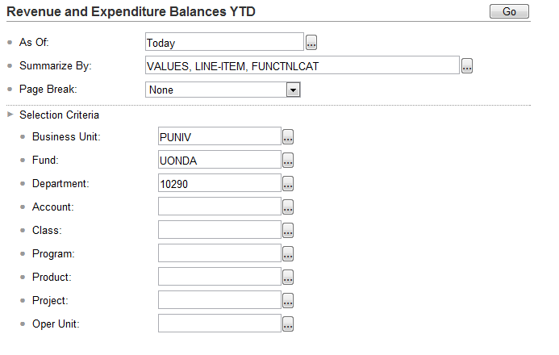
How much money can I spend?
Simpler Budget Report
Wavenet>My Work>Reporting>Simpler Systems
Query>Budget Balances YTD (combined)

Slide 14
Simpler Budget Report
Need Simpler Access?
http://community.pepperdine.edu/finance/content/forms/sys-financials-access-application.pdf

Slide 15
Other Fascinating Topics
Gift Cards: Easy to give; a pain for everything else
IRS says that gift cards = cash, thus any gift card becomes taxable income
Either taxable to recipient, if University employee, or taxable to the giver, if we can’t identify the recipient.
Tangible gifts are taxable in excess of $25
Movie tickets, t-shirts, books
Employee recognition/retirement gifts taxable in excess of $400.

Slide 16
Questions?
Thank you!
http://community.pepperdine.edu/finance/

